Slide 1
The Digital Pink Slip:
A Blockchain Use Case for Automobile Registration
Cory Campbell, PhD, CPA, CGMA, CFE
Indiana State University
Dijo Alexander, PhD
Head of Technology , SAP (Litmos eLearning)
Notes:
44

Slide 2
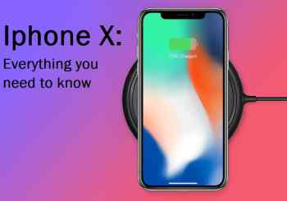
It all began…...June 29, 2007
Notes:
Eric from KPMG—Why now?
A: Customer expectation and customer experience

Slide 3
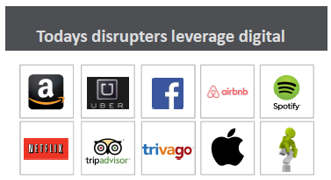
Audit of the Future
“It’s important for today’s auditors to be at the forefront of disruptions, such as blockchain, and to identify ways to innovate to advance audit quality and to align auditing capabilities with the changes occurring in the marketplace. ”
Frank Casal, vice chair of audit KPMG

Slide 4
Agenda
What is Blockchain?
How Does it work?
Use Case
Proof of Concept
Conclusion
What’s Next….

Slide 5
What is a Record? Block?? Blockchain???
Records
Can be any information
All the information about the asset
Blocks
Collection of records
Blocks are a snapshot of each of state
Track an asset whose state changes
Blockchain
Continuously updated record of who holds what
Representation of the continuous “change of state”
is the ledger

Slide 6
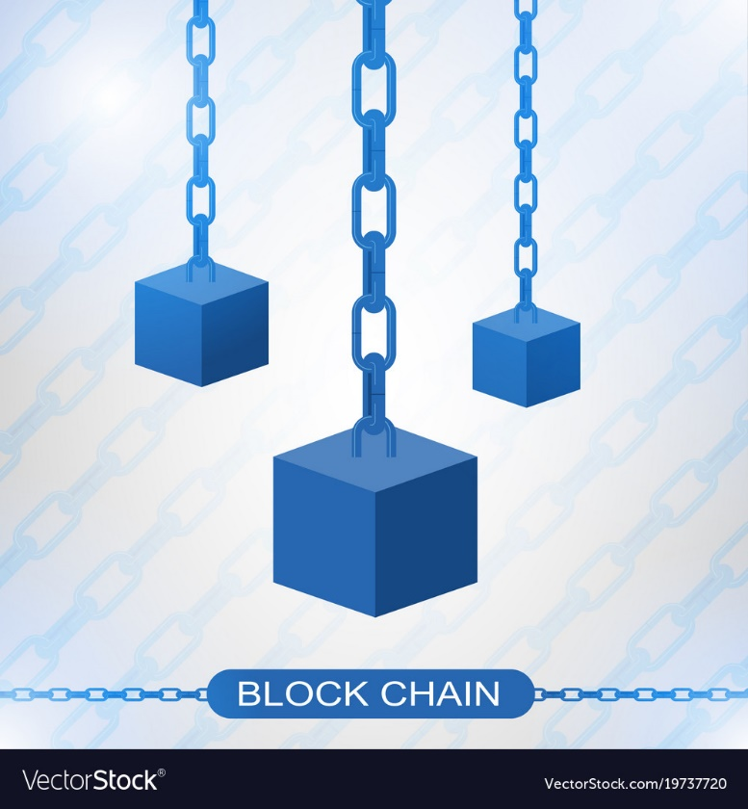
What is Blockchain?
Self-sustaining, peer-to-peer database for managing and recording transactions with no central bank or clearinghouse involvement
“Blockchain” is named after how transactions are stored—blocks of data, encrypted by altering (or hashing) part of the previous block
Blockchain is the representation of the continuous “change of state”

Slide 7
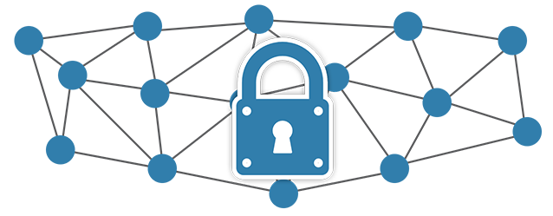
How Does it Work? No Central Authority
Historically, we have had to rely on third party institutions (e.g. government, financial institutions, large corporations) to manage the integrity, trust, and transaction itself. In a way, we have shifted that protocol to the underlying technology of Blockchain.
Bill Briggs, managing director, US and Global Chief Technology Officer, Deliotte Consulting LLP

Slide 8
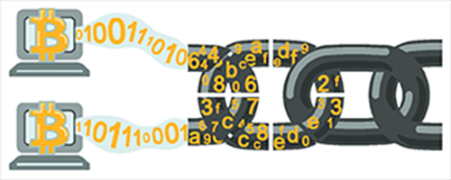
How Does It Work?
System is presumed immune to tampering, fraud, or political control
Handled through algorithms and consensus among multiple computers
Designed to protect against domination of the network by any single computer
Every transaction is processed just once, in an electronic ledger
A Strategist’s Guide to Blockchain

Slide 9
Asset, Participant, Transaction
What is Blockchain used for?
Blockchain is a technology used for managing the exchange of assets.
Asset
An asset can be anything of value.
Include physical or non-physical asset.
e.g.) currency, real estate, inventory, EMR
Participant
Organization or people who take part in the digital business network
who exchange these assets
Transaction
Submitted by a participant to affect the assets
Exchange itself during which there is a change of state
(a new block is created)
Wherever there is “change of state”, there is new block
Notes:
https://hyperledger.github.io/composer/latest/reference/glossary

Slide 10
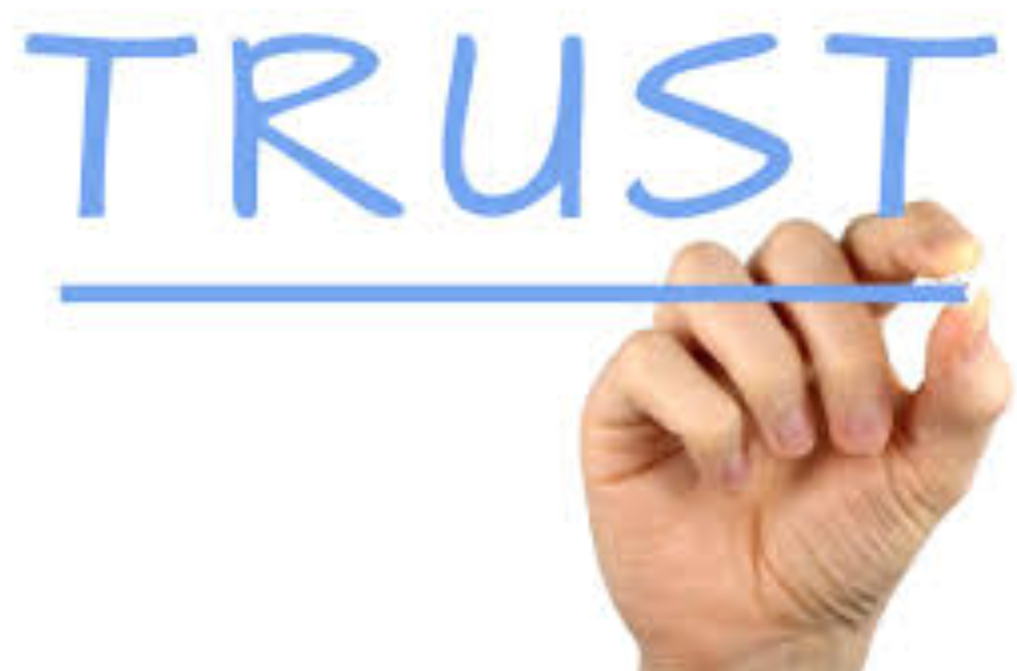
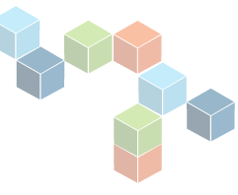
The problem with traditional transactions…..
Why do we need Blockchain?
The seller doesn’t trust the buyer
The buyer doesn’t trust the seller
Buyer and seller must rely on the third party
Can we have a system where trust exists on the transaction and not the central authority?
Notes:
BC is a mechanism to trust the transaction

Slide 11
What obstacles inhibit Trust?
How can to build Trust
Tampering
Lack of Transparency
Confirmation
Double spending problem

Slide 12
Immutability for “Trust”
Problem: Tampering
Solution: Immutability
Hash is mathematical algorithm
that allows one way encryption
“easy” to compute & “difficult” to reverse.
Immutability →Crypto-technology
Notes:
If record change, then it the hash changes b/c of algorithm

Slide 13
Crypto-technology
How much money would you have if you doubled one cent every day for one month?
$10,737,418.24
2³⁰ = 1,073,741,824
How does that translate to 256 bit electronic signature?
2²⁵⁶ =
115,792,089,237,316,000,000,000,000,000,000,000,000,000,000,000,000,000,000,000,000,000,000,000,000,000
Great Video on Crypto-technology
https://www.youtube.com/watch?v=S9JGmA5_unY
Notes:
David Haines from Oracle—reference “level” of trust.
This matters for permissioned vs unpermissioned

Slide 14
Public and Private Keys
Private Key: Sign (Message,sk) = Signature
Public Key: Verify (Message, 256 bit Signature, pk) = T/F
00000000000000010000000000000000
00000000000000000000000000000000
00000000000001000000000000000000
00000000000000000000000000000000
00000010100000000000000000000000
00000000000000000000100000000000
00000000000000000000000000000000
00000000000000000000000001000000
Public Key (pk): 01000111…..
Private Key(sk): 10010011…..

Slide 15
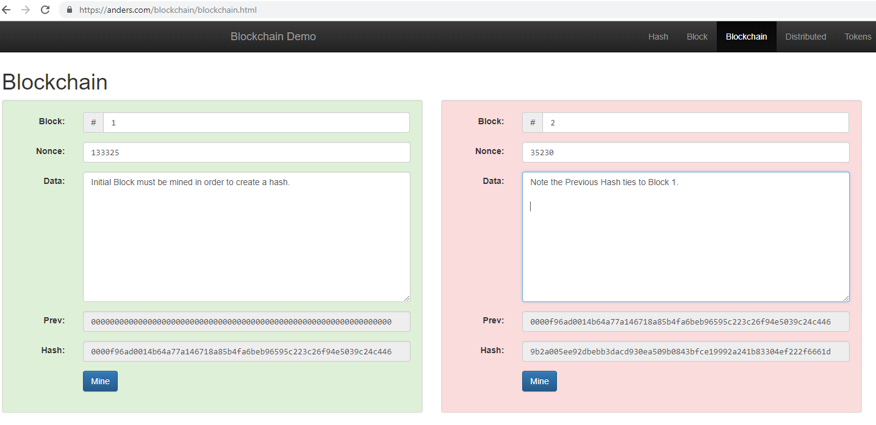
What is a Hash?
https://anders.com/blockchain/blockchain.html

Slide 16
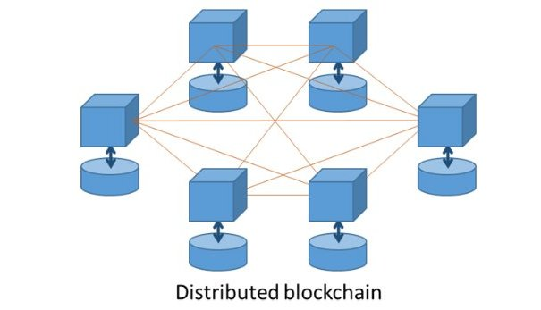
Provenance for “Trust”
Problem: Transparency
Solution: Distributed Ledger
The chain is the ledger.
Clear picture of the history of the chain itself
Gives you confidence and helps create trust
Provenance → Distributed Ledger
Notes:
Provencence (History)

Slide 17
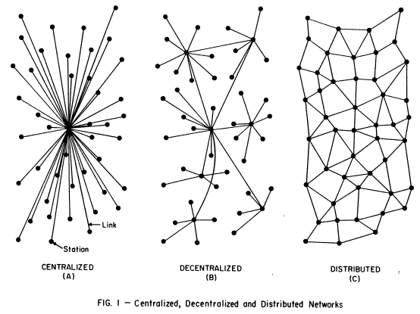
What are Distributed Ledgers
Centralized Decentralized Distributed

Slide 18
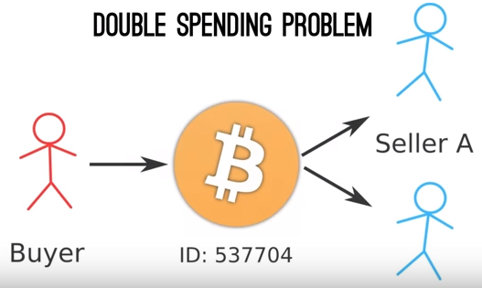
Finality for “Trust”
Problem: Double Spending
Solution: Finality (new block)
Block is only added after validation.
Crypto has network of miners (validators)
Algorithm to auto-validate the authenticity of prior blocks
Finality → Verification e.g.) Proof of Work
Notes:
“Double Spending Problem” problem of two copies of something that should only have one unique identity

Slide 19
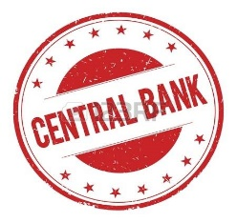
Consensus for “Trust”
Problem: No Central Authority
Solution: Verification/Acceptance
e.g.) mining
We build consensus by:
Validation of each transaction.
Participants in the chain can raise red flags
Consensus → No Central Authority

Slide 20
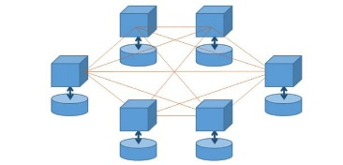
Build Trust in a “Trustless” System
Immutability →Crypto-technology
Provenance → Distributed Ledger
Finality → Verification e.g.) Proof of Work
Consensus → No Central Authority

Slide 21
Adding Value through Blockchain
Recordation—track ownership of the physical asset
e.g.) Stocks, bonds, money, artwork, votes, and digital identity
Value Exchange—transfer of ownership
e.g.) Everyone on systems knows when an asset is sold
Smart Contracts—imbedded ledger is immutable
e.g.) Buying a car in minutes not days

Slide 22
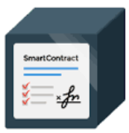
We can trust the transaction
Build Trust in a “Trustless” System
But…..
Can we add conditions and/or constraints to our transaction??
Smart Contracts
Notes:
BC is a mechanism to trust the transaction

Slide 23
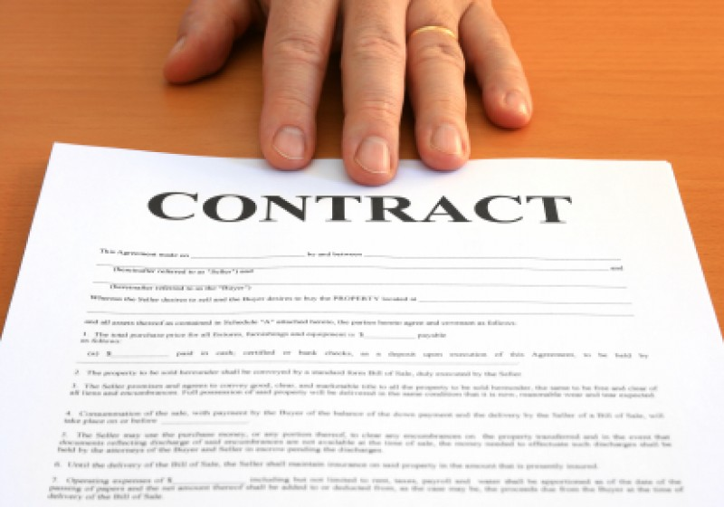
Contracts
A contract is:
A promise or a set of promises for the breach of which the law gives a remedy or the performance of which the law in some way recognizes a duty.
Parties of a Contract:
At least 2 parties
Offeror
Makes an offer
To do or not do something
Offeree
Person to whom offer is made
If accepted, then contract

Slide 24
Contracts
Elements of a Contract:
Agreement
Offer and acceptance; mutual assent
Consideration
Money, property, services
Contractual Capacity
Lawful Object
Smart Contracts (1996) “a set of promises, specified in digital form, including protocols within which the parties perform on those promises”
“Smart Contracts” were formally proposed in 1996!
~Nick Szabo, Smart Contracts: Building Blocks for Digital Markets, EXTROPY, 1996.

Slide 25
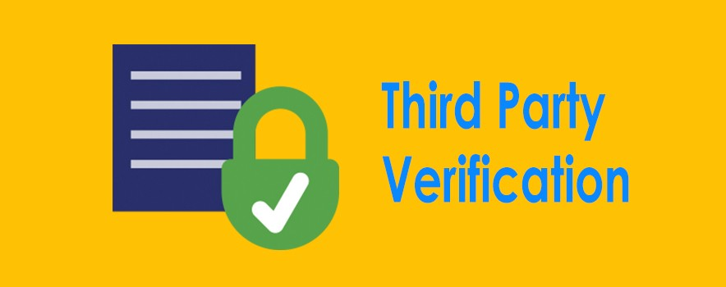
Traditional Contracts
Paper Contract
Cory agrees to pay $20K for the car. Once Claire gets the deposit, she will transfer the vehicle ownership to Cory by handling him over the car documents and the car.
Signature

Slide 26
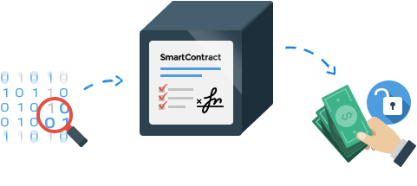
Smart Contracts
Problem: Adding Conditions/Constraints
Solution: Smart Contracts
Smart contract as a script (rules)
Executed before the new block will be created.
Any failure = lack of finality and new block will not be created.
Add Conditions to transactions
→ Smart Contracts
Notes:
https://www.google.com/search?tbm=isch&source=hp&biw=1500&bih=864&ei=z7mEW9fdDcjJjwS2gqXwDQ&q=smart+contract&oq=smart+contract&gs_l=img.3..0l10.4930.9722.0.10426.24.17.2.2.2.0.372.1645.0j7j1j1.9.0....0...1ac.1.64.img..11.13.1690.0..35i39k1.0.7e34pTNw5o0#imgdii=oUdEQAHtCJHteM:&imgrc=4u5ome5MrB7JJM:

Slide 27
Smart Contracts
Bill leaves the boat and a key on the lot with a smart contract controlled lock. That boat has a (pk) =123456
❷
❶
Bill wants to sell a boat. He identifies himself with his public (pk)= 730484) and uses a smart contract to define the terms of the sale with his private key.
❷
❻
Phyllis can unlock smart contract with (sk) and pick up boat
Smart Contract
If $20K is sent to account (pk 730484) then automatically transfer boat ID 4920x8 and smart access to the account that transferred the funds.
Digital Signature
The smart contract is verified by each node on the network if Bill is the owner of the boat and if Phyllis have enough money to pay.
Network agrees, all conditions are true. Phyllis automatically gets access to the smart garage lock. Money exchanges and a new block is created.
❹
❺
❸
Phyllis wants to buy the boat. She finds the boat on the internet. She signs the contract with her private key transferring $20K from her blockchain address (sk) to Bill’s blockchain address 730484
Notes:
https://blockchainhub.net/blog/infographics/smart-contracts-explained/

Slide 28
Smart Contracts
No court cases in US providing direct guidance on the enforceability of smart contracts.
McKinney, S. A., Landy, R., & Wilka, R. (2018). Smart Contracts, Blockchain, and the Next Frontier of Transactional Law. Wash. JL Tech. & Arts, 13, 313.
Notes:
https://www.google.com/search?rlz=1C1GCEA_enUS801US801&tbm=isch&q=sap+infographic+blockchain+technology&backchip=online_chips:ibm&chips=q:sap+infographic+blockchain+technology,online_chips:cryptocurrency&sa=X&ved=0ahUKEwigkr7PwuPcAhXM6oMKHRNRDXoQ4VYIJigB&biw=1363&bih=785&dpr=2.2#imgrc=3d_Os3nQfPgXRM:

Slide 29
Smart Contracts as “Digital Constraints”
Smart Contracts are:
Examples of Smart Contracts:
Not “Smart” or a “Contract”
Self-governing contracts
Simplify and automate lengthy and inefficient business processes.
Terms and conditions are recorded in the contract’s code.
Shared network automatically executes the contract and monitors compliance.
Outcomes are validated instantly without a third party.
Self-executing
Only used in North America
Cannot ship to California
Validate age
e.g.) selling tobacco/liquor to minor
Only physicians can validate EMR (HIPPA)
Cannot sell prior to Jan 1, 2020 at 12:00pm
If sold, then must pay royalty
Interstate Commerce (Sherman Act)
Electronic Signatures in Global and National Commerce Act (E-Sign Act) of 2000 gives the legal effect to electronic signatures e.g.) DocuSign
Notes:
Not Smart! No AI, Machine Learning, or Modification
Simply a pre-defined script

Slide 31
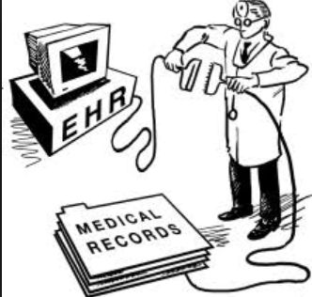
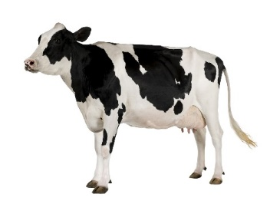
What are the possibilities?
Gartner research predicts there will be over 26 billion connected devices by 2020
Notes:
Walmart→best test with IBM 7 days manual tracking vs 2.2 seconds in blockchain
https://techcrunch.com/2018/09/24/walmart-is-betting-on-the-blockchain-to-improve-food-safety/
LOGISTICS—Europe’s largest port researching logistics applications
UTILITIES—Trading energy futures at electric vehicle charging stations
SOCIAL MEDIA—Users have added opportunity to own and control their images/content
HEALTHCARE—Transform electronic health records
FINANCE—Smart bonds and smart contracts
INSURANCE—Encryption with claims processing
BANKING—Cross-border transactions
EDUCATION—Texas system investing in Blockchain for student transcripts
Add voting

Slide 32
Banking Applications

Slide 33
Non-Financial Blockchain Uses
Reference: van Loon: Let’s Talk Payments
Notes:
VOTING—ZUG, SWITZERLAND
BIRTH RECORDS—(FOSTER CHILDREN AND ORPHANS),
https://www.google.com/search?rlz=1C1GCEA_enUS801US801&tbm=isch&q=sap+infographic+blockchain+technology&chips=q:sap+infographic+blockchain+technology,online_chips:ibm,online_chips:cryptocurrency&sa=X&ved=0ahUKEwiMjv3KwuPcAhVk2IMKHRJeB14Q4lYILigF&biw=1363&bih=785&dpr=2.2#imgrc=ciyuD8NQjS2TXM:

Slide 34
Non-Financial Blockchain Uses
https://illinoisblockchain.tech/blockchain-cook-county-final-report
https://medium.com/uport/zug
Notes:
VOTING—ZUG, SWITZERLAND
BIRTH RECORDS—(FOSTER CHILDREN AND ORPHANS),
https://www.google.com/search?rlz=1C1GCEA_enUS801US801&tbm=isch&q=sap+infographic+blockchain+technology&chips=q:sap+infographic+blockchain+technology,online_chips:ibm,online_chips:cryptocurrency&sa=X&ved=0ahUKEwiMjv3KwuPcAhVk2IMKHRJeB14Q4lYILigF&biw=1363&bih=785&dpr=2.2#imgrc=ciyuD8NQjS2TXM:
https://medium.com/uport/zug-id-exploring-the-first-publicly-verified-blockchain-identity-38bd0ee3702

Slide 35
Types of Blockchains
Public (Permissionless) vs Private (Permissioned)
Notes:
https://www.bing.com/images/search?view=detailV2&ccid=u3kCVD6k&id=F19586D358A8B388C3EA7A70B7AF8FFF5EF6C32F&thid=OIP.u3kCVD6ktV_jjkJJuQHA7wHaFj&mediaurl=https%3A%2F%2Fimage.slidesharecdn.com%2Fv3-q32015sob1-151014141801-lva1-app6892%2F95%2Fstate-of-bitcoin-and-blockchain-q3-2015-68-638.jpg%3Fcb%3D1453145721&exph=479&expw=638&q=Blockchain+Public+Vs.+Private+vs+consortium&simid=607992033968196413&selectedindex=19&cbir=sbi&ajaxhist=0&vt=Default

Slide 36
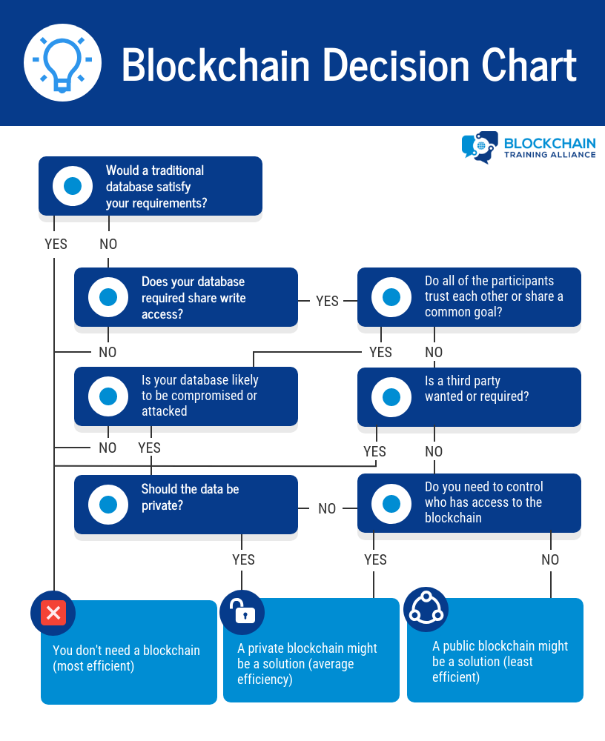
When to Blockchain Technology

Slide 37
How to do you build Blockchain?
Need to depend on Blockchain database
What are the BlockChain databases that are out there?
Microsoft--Azure Blockchain Workbench
Oracle Autonomous Blockchain Cloud Service
Intel’s Sawtooth
SAP HANA Blockchain
IBM Hyperledger Fabric
Apache Hyperledger (open source)
Notes:
Apache is an open source foundation (linux, tomcat, eclipse, Cassandra, Hadoop)
IBM Hyperledger is a commercial application of apache hyperledger

Slide 38
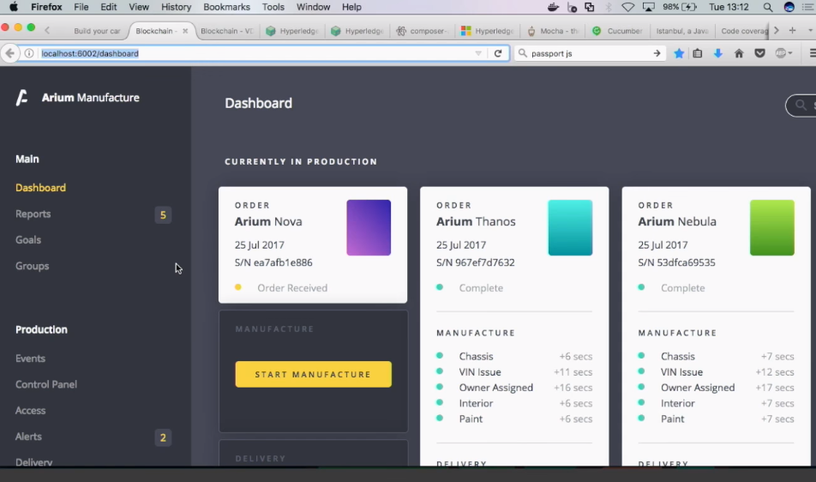
Application Architecture
(API) Application Programming Interface
Blockchain Database
User Interface
Relational Database
User Interface
Notes:
https://www.hyperledger.org/projects/fabric

Slide 39
Data Exchange Built on Blockchain
Reference: Fujitsu.com
Notes:
https://www.google.com/search?tbm=isch&q=sap+blockchain+smart+contract&backchip=online_chips:hyperledger&chips=q:sap+blockchain+smart+contract,online_chips:fabric&sa=X&ved=0ahUKEwjhpciRpIzdAhUE9IMKHWS0CKEQ4VYIJigB&biw=1000&bih=576&dpr=3#imgrc=VaWbC8SxNpA9jM:

Slide 40
Proof of Concept
The Digital Pink Slip:
A Blockchain Use Case for Automobile Registration

Slide 41
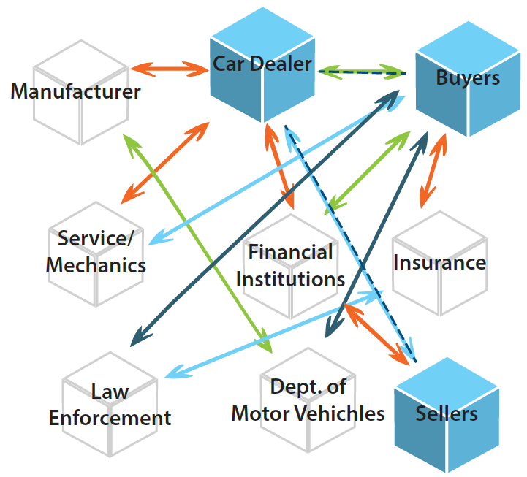
The Digital Pink Slip:
A Blockchain Use Case for Automobile Registration
Assets = cars
Transactions = buying and selling of cars
Participants =

Slide 42
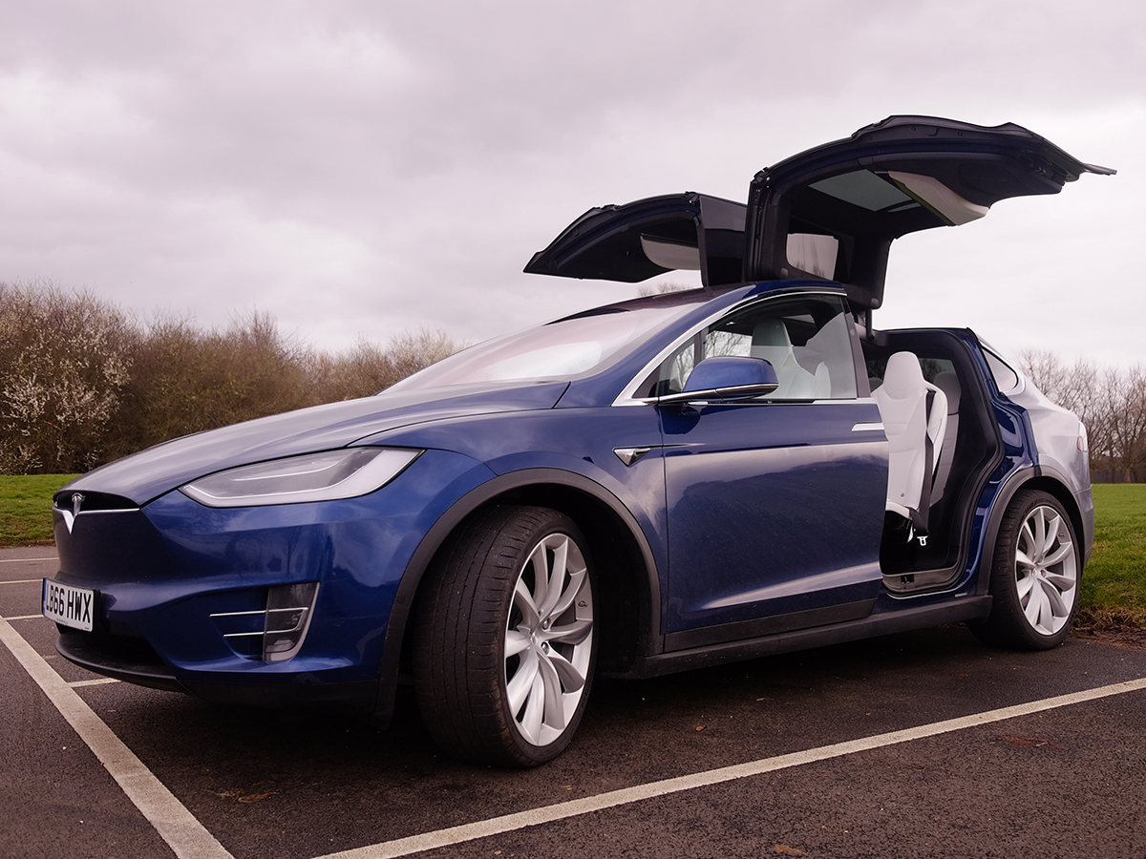
Use Case: Block 101
Blockchain Transaction:
Dijo’s Autohaus buys a car from the OEM Manufacturer.
A new block (101) is created
Title changes from Telsa (OEM) to Dijo
Block 101
Previous Hash: fec04740-d898-43ac-b45v-69b8304c917a
Hash: 01ea7ld5-52ec-4c34-b853-1b315aa4052a
Time stamp: September 1, 2018 11:49am UTC
VIN
Year
Make
Model
Color
Titleholder
Insurance Coverage Registration
Status
Smart Contract
1L81SJX26SA003608
2018
Tesla
Model X
Blue
Dijo’s Autohaus
[…]
[…]
Complete
[…]
100
The chain originates with the OEM manufacturer
101

Slide 43
Use Case: Block 102
Blockchain Transaction:
Dijo’s Autohaus sells the car to Cory Campbell.
A new block (102) is created
Title changes from Dijo’s Autohaus to Cory
Block 102
Previous Hash: 01ea7ld5-52ec-4c34-b853-1b315aa4052a
Hash: jKla781d-4358-cjao5848a3-89jlxlejb8s0ak
Time stamp: September 2, 2018 7:32 pm UTC
VIN
Year
Make
Model
Color
Titleholder
Insurance Coverage Registration
Status
Smart Contract
1L81SJX26SA003608
2018
Tesla
Model X
Blue
Cory Campbell
[…]
[…]
Complete
[…]
100
101
102

Slide 44
Use Case: Block 103
Blockchain Transaction:
Cory sells the car to Kim.
A new block (103) is created
Title changes from Cory to Kim
Block 103
Previous Hash: jKla781d-4358-cjao5848a3-89jlxlejb8s0ak
Hash: a8akdidb-a8d9-a98ldkac99-jas8jalwpqzod
Time stamp: September 4, 2018 9:15am UTC
VIN
Year
Make
Model
Color
Titleholder
Insurance Coverage Registration
Status
Smart Contract
1L81SJX26SA003608
2018
Tesla
Model X
Blue
Kim Herb
[…]
[…]
Complete
[…]
100
101
102
103

Slide 45
Use Case: Can we sell to two people?
Double spending is trying to sell the same assets twice, to two different people.
Block
Previous Hash: a8akdidb-a8d9-a98ldkac99-jas8jalwpqzod
Hash:
Time stamp: September 1, 2018 11:49am UTC
Blockchain Transaction:
Cory sells the car to Claire
Cory owns Block 102—not the latest block in the chain
Transaction Why?
VIN
Year
Make
Model
Color
Titleholder
Insurance Coverage Registration
Status
Smart Contract
1L81SJX26SA003608
2018
Tesla
Model X
Blue
Cory Campbell
[…]
[…]
Complete
[…]
Algorithm designed to ensure prior block is the longest
No new Block Created
100
101
102
103

Slide 46
Use Case: What if a Block is altered?
Cory alters Block 103 by changing the Title holder to back to himself.
Block
Previous Hash: a8akdidb-a8d9-a98ldkac99-jas8jalwpqzod
Hash:
Time stamp: September 1, 2018 11:49am UTC
Blockchain Transaction:
Title changes from Kim Herb back to Cory Campbell.
Cory tries to sell the car to Steve Lamb.
Transaction Why?
VIN
Year
Make
Model
Color
Titleholder
Insurance Coverage Registration
Status
Smart Contract
1L81SJX26SA003608
2018
Tesla
Model X
Blue
Cory Campbell Kim Herb
[…]
[…]
Complete
[…]
Change in Record changes the HASH. Hash no longer links to the previous hash
No new Block Created
100
101
102
103
Cannot change a block--Immutability
Notes:
I

Slide 47
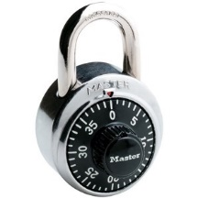
What is a Hash?
https://anders.com/blockchain/blockchain.html

Slide 48
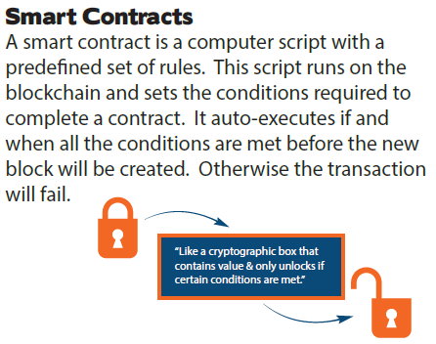
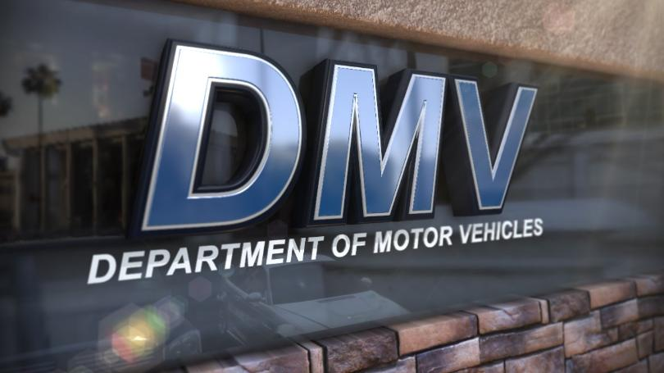
Use Case: Addition of Smart Contracts
A smart contract is added by ___ to require registration with the Department of Motor Vehicles before any sale is complete.
100
101
102
103
New Block

Slide 49
Use Case: Addition of Smart Contracts
Blockchain Transaction:
Kim sells the car to Alan, but the transaction fails.
Transaction Why?
Block 104
Previous Hash: jKla781d-4358-cjao5848a3-89jlxlejb8s0ak
Hash: a8akdidb-a8d9-a98ldkac99-jas8jalwpqzod
Time stamp: September 4, 2018 9:15am CST
VIN
Year
Make
Model
Color
Titleholder
Insurance Coverage Registration
Status
Smart Contract
1L81SJX26SA003608
2018
Tesla
Model X
Blue
Cory Campbell
[…]
[…]
Complete
[DMV Registration]
Kim did not register with the DMV
This Block Fail….Block 104 is NOT created
100
101
102
103
104

Slide 50
Use Case: Addition of Smart Contracts
Blockchain Transaction:
Kim sells the car to Alan, but the transaction fails.
Kim registers with DMV
Smart contract executes
Block 104 created
Block 104
Previous Hash: a8akidb-a8d9-a98ldkac99-jas8jalwpqzod
Hash: a89d02k-kald9-bjao89e0d-z938akdho3jd
Time stamp: September 5, 2018 3:47pm CST
VIN
Year
Make
Model
Color
Titleholder
Insurance Coverage Registration
Status
Smart Contract
1L81SJX26SA003608
2018
Tesla
Model X
Blue
Alan
[…]
[YES]
Complete
[DMV Registration]
100
101
102
103
104
DMV

Slide 51
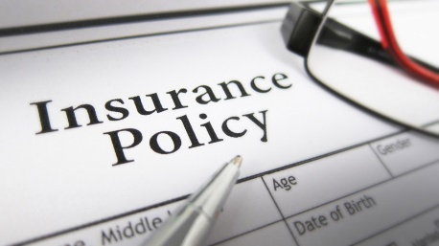
Use Case: Addition of Smart Contracts
A smart contract is added by ___ to require insurance with ____ before any sale is complete.
100
101
102
103
104
New Block
DMV
DMV
Insurance

Slide 52
Use Case: Addition of Smart Contracts
Blockchain Transaction:
Regulatory body requires proof of insurance must be on file with the DMV.
Alan submits her proof of insurance to the DMV
Smart contract executes
Block 105 created
Alan retains Title
Block 105
Previous Hash: 89d02k-kald9-bjao89e0d-z938akdho3jd
Hash: 9adkaigh-d8ad-mazpd8dd3-1k90ziah89a4
Time stamp: September 6, 2018 1:23pm CST
VIN
Year
Make
Model
Color
Titleholder
Insurance Coverage Registration
Status
Smart Contract
1L81SJX26SA003608
2018
Tesla
Model X
Blue
Alan
[…]
[YES]
Complete
[Insurance] [DMV]
100
101
102
103
104
105
DMV
Insurance

Slide 53
Review: What happened?
#101
Transaction ID01ea7ld5-52ec-4c34-b853-1b3 15aa4052a102
Time Stamp: September 1, 2018 11:49 am UTC
#102
Transaction ID: jKla781d-4358-cjao5848a3-89jlxlejb8s0ak
Time Stamp: September 2, 2018 7:32 pm UTC
#103
Transaction IDa8akdidb-a8d9-a98ldkac99-jas8jalwpqzod
Time Stamp: September 4, 2018 9:15 am UTC
#104
Transaction ID: 8a9d02k-kald9-bjao89e0d-z938akdho3jd
Time Stamp: September 5, 2018 3:47pm UTC
#105
Transaction ID9adkaigh-d8ad-mazpd8dd3-1k90ziah89a4
Time Stamp: September 6, 2018 1:23 pm UTC
Recent Transactions:

Slide 54
“Trusting” the Transactions
Immutability → Altering block (e.g. changing titleholder) changed the hash
Provenance → participants can see where block originated as well as ownership
Finality → Single, trusted source of ownership and transaction history
Consensus → All the blocks in a chain must agree on the transactions validity

Slide 55
What’s Next?
Regulation
Emissions
Insurance
Registration
Innovation
Certified mechanics
Certified parts
Safety
Valid licenses
Proof of Insurance
Registration
Disruptive Innovation
Future for CarFax and Kelley Blue Book?

Slide 56
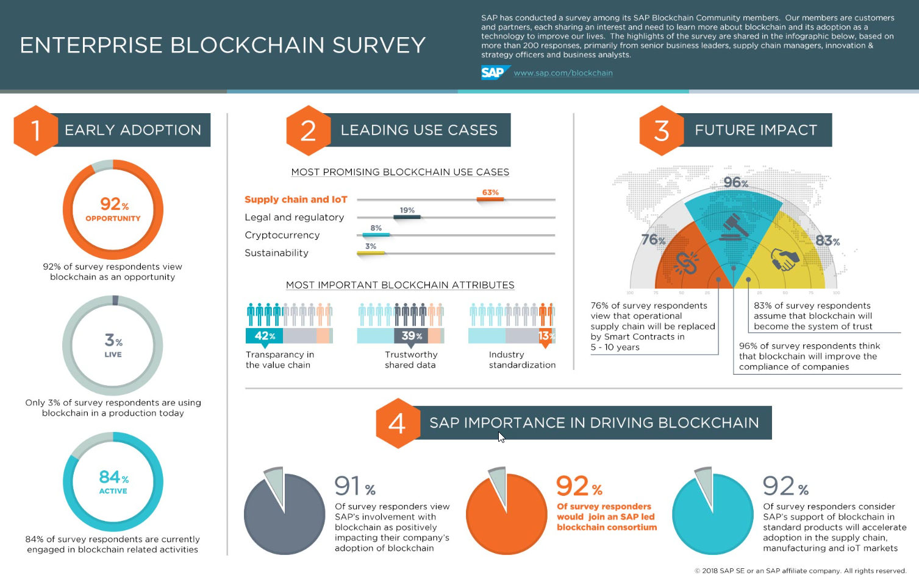

Slide 57
What’s Next?
Notes:
Power: Smart meters? AZ Salt River Project
Prepaid power
Users see real time usage
Power: Smart Grids Park Slope Project in Brooklyn, NY
130 building—sell “extra” energy
Hurricane Sandy—1 month later 1% no power
Florence, Katrina, Houston…..plus respond to terror attack

Slide 58
Implications for the Accounting Profession
“A world where all transactions for a company occur on the blockchain would enable auditors to verify large amounts of routine data automatically, allowing them to focus instead on more complex transactions and controls”
Kimberly Ellison-Taylor, chairman of the AICPA ~ December 5, 2017
“The accounting profession is built on confirmation and verification, and that’s what blockchain is all about.”
“Blockchain is one of the technologies that are ‘shaping’ the accounting industry.”
Barry Melancon, AICPA president and CEO ~ October 23, 2017
Erik Asgeirsson, president and CEO of CPA.com ~ October 23, 2017
Notes:
1 + 2) AICPA and Wall Street Blockchain Alliance Accounting Today 10/23/17
3.) Blockchain considerations for managements and auditors Journal of Accounting 12/5/17

Slide 59
What Do Accountants Need to Know?
Potential uses for blockchain in accounting and audit:
Immutable records
Traceable audit trails
Automated audit processes
Authentication of transactions
Tracking ownership of assets
Development of “smart contracts”
Registry and inventory system for any asset, ranging from raw materials to intellectual property
Notes:
Mike from Deloitte→more focus on controls and real time annomalies

Slide 60
What Does it Mean for Accountants?
Impact on audit practices:
blockchain in accounting & audit greatly reduces potential for errors when reconciling complex & disparate information from multiple sources
accounting records not alterable once committed even by the owners of the accounting system
every transaction is recorded & verified—the integrity of financial records is guaranteed
potential to greatly reduce or even eliminate the need for auditing resources
Increased need to audit controls and transaction anomalies
potentially disrupting accounting profession as a whole

Slide 61
Conclusion:
A “Block” is a snapshot of the “change of state” to the asset
Blockchain has the potential to shift the nature of Accounting
Blockchain has the potential to vastly automate the accounting process in compliance with regulatory requirements
Blockchain will have a useful impact in every business
The Accounting profession has a unique opportunity to define the blockchain agenda
The future of Blockchains lies in smart contracts and supply chain
Embrace the hype and before it’s forced upon you!
Lead with technology, rather than follow it.

Slide 62
The Digital Pink Slip:
A Blockchain Use Case for Automobile Registration
Questions?
Cory Campbell, PhD, CPA, CGMA, CFE
Indiana State University
Dijo Alexander, PhD
Head of Technology , SAP (Litmos eLearning)

